Slide 1
BIM in Practice
An Architect's Perspective
Notes:
Welcome, thanks to NBS for asking me to speak
Great to see so many Manufacturers interested in BIM

Slide 2
Small Print
Notes:
I think before I start I need to point out a minor issue with my presentation today and I hope you don’t hold this against me…
Although this is titled an Architects Perspective, in the current company of RIBA I’m advised to tell you that I’m not in fact an Architect and I am only a mere Technician… Your more than welcome to banish me to the depths of RFI’s and Door Schedules, but I do hope that you find this presentation helpful non the less.

Slide 3
About Us
Founded by Andrew Ward.
Recently celebrated 10 years of business.
Based in Staffordshire.
Custodians of Asda’s Prototype Model Stores.
Using Autodesk products predominantly.
Full Autodesk Suites & LT Suites.
@JamesWardLtd
| #BIMforManufacturers
Notes:
Brief overview, Social Networking

Slide 4
About Me
Joined Andrew 3 months after starting up.
Career of 17 Years in Architecture.
Converted Asda’s Prototype Store info from AutoCAD to Revit in 2008.
Delivered Asda’s First Store in BIM.
Designed over 1 million square feet of Retail Space in BIM.
@Anthony_Harte
| #BIMforManufacturers
Notes:
I’ve been everything from BIM Manager, Technical Design Manager, Director…
17 Years in Architecture, 16 of that in Retail Architecture, and 10 years with James & Ward
Started in BIM circa 2008, converted Asda Details
Million square foot in BIM
And I’m also….. (Hang Back on Secondment Position for next slide)

Slide 5
On Secondment to Asda, in Construction Design Standards Team
Sit on the Asda BIM Strategy Board.
Notes:
…..on Secondment to one of the biggest Retailers.
Predominant Role is to implement change process from stakeholders and feedback.
One thing that this position has taught is that retailers speak a diff language

Slide 6
Understanding Language
“Twerk”
To dance using predominantly your bum.
Where people in Yorkshire go Monday to Friday, 9-5pm.
Notes:
…..on Secondment to one of the biggest Retailers.
Predominant Role is to implement change process from stakeholders and feedback.
One thing that this position has taught is that retailers speak a diff language

Slide 7
What does it mean to a Retailer?
Notes:
I’ve got a video I put together for the Exec’s, and you will notice this isnt about BIM and Families.
It’s about the outcome, and what the end result is.
Retailers sell stuff, and this industry shift will help keep that edge in a very competitive environment.

Slide 8
PLAY VIDEO
Notes:
PLAY VIDEO

Slide 9
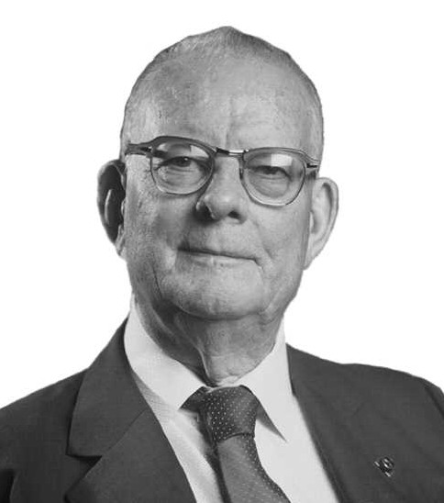
“Without Data, you’re just another person with an opinion”.
W. Edwards Deming
Notes:
William Edwards Deming (1900 –1993)
American engineer, professor, author, lecturer, and management consultant

Slide 10
Monochrome World
Early Colour
Digital HD
4k Digital (Super HD)
Notes:
People use many comparisons for the evolution our industry is undergoing, and I’ve today taken the view to use TV
Black & White early TV, No Sound, Grainy Picture, Early Colour TV, a bit clearer, Digital TV, more immersive, Super HD, Curved Screens etc.

Slide 11
A Digital Future
More Defined
Gives Clearer Picture
More Data
Notes:
You may be thinking, what’s a TV got to do with BIM?
Over the years, we have seen a move from Analog to Digital
More defined, more immersive, and gives a clearer picture into what’s happening.
The same can be said for our industry.

Slide 12
Our move to BIM has:
Organically grown, no targets or management process
2008
2009
2010
2011
2012
2013
2014
2015
2016
2D CAD TO
3D REVIT
FIRST BIM NEW BUILD
FIRST BIM MEZZ REFURB
MODEL 2009
GORSEINON
BARNES HILL
MODEL
MODEL 2010
MELKSHAM
MOSBOROUGH
LEVEL 2 BIM
SUNDERLAND MEZZ
OUR FOCUS
CLIENT FOCUS
CONTRACTOR FOCUS
QS COSTING FOCUS
FM & LIFESCYCLE COSTS
3D VISUALISATION
FEE REDUCTION
REPEAT DESIGN
STANDARD DETAIL
PHASING
REDUCE DESIGN PERIOD
CLASH DETECTION
VALUE ENGINEER
COMMUNICATION AT SITE LEVEL
COST VARIFICATION
QUANTITY SCHEDULES
INCREASED DATA
DATA DROPS
Notes:
Began in 2008, Walmart Instructed Asda to use “Revit”, Forced our Hand, Use it or we find someone that will….
At the time, no Employer Direction, no targets or standards available and we didn’t know this was BIM so we just began.
Started the journey and the results became our focus and then our clients focus.
NEXT SLIDE Jumping back to 2008…

Slide 13
Experiences Adopting
Starting Out
3 Day Initial Training
Straight into Modelling
No Asda Components!
Onsite Live Project Training
Issues
License Costs
Data Sharing
Level of Detail / Information
No Client Requirements
Notes:
So, 9 Years ago on a hot summers day, 3 day training, had to model an entire 40k asda.
Where to start? No cladding, No Doors, No Roof lights, infact nothing asda related…
Do we model skirting, floor vinyl, cladding by panels or single wall.
No Client input, no AIM for FM, contractually we had to deliver traditional drawings but in Revit, and coordinate with SE & M&E

Slide 14
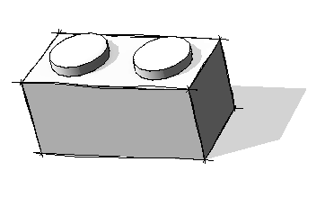
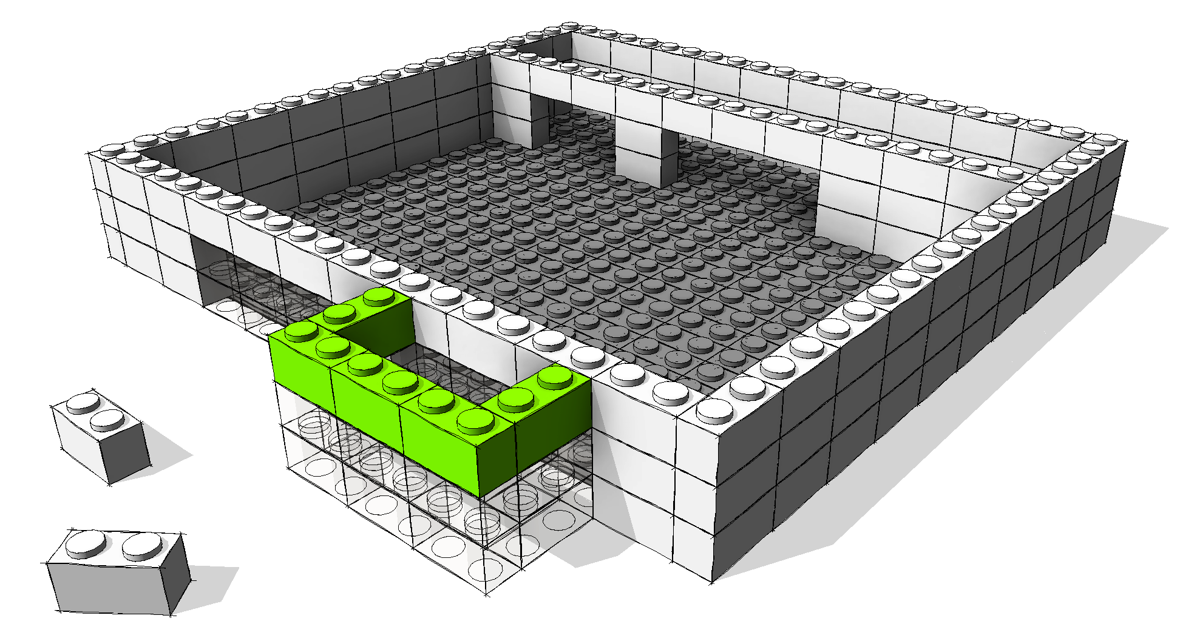
Business Impact
Notes:
Where do we get these building components from, as we needed a large amount to build our 40k store?
How did we know what LOI or LOD we required, and more importantly the outputs we required from these components.
This all seems simple now looking back, but at the time it was an unknown.

Slide 15
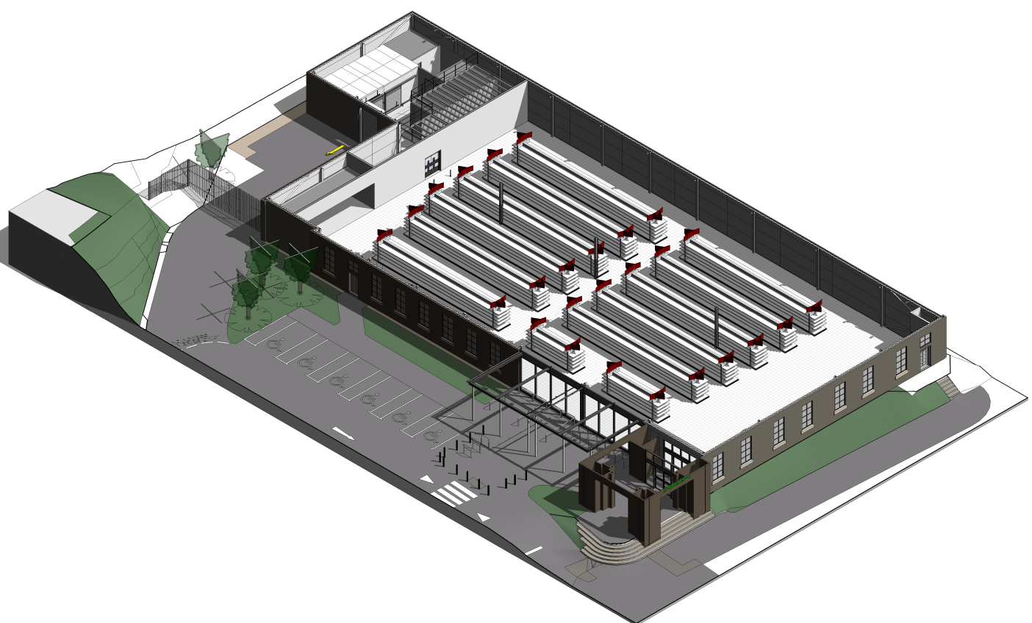
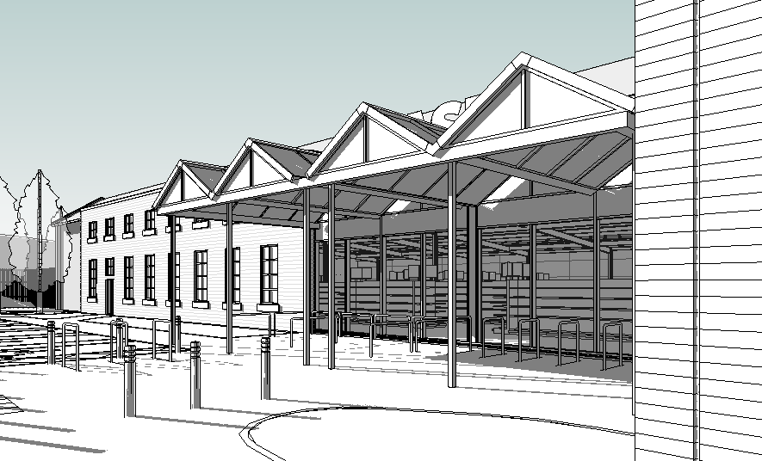
Business Impact
Not all Stores are created equal
Some schemes were bespoke
No library

Slide 16
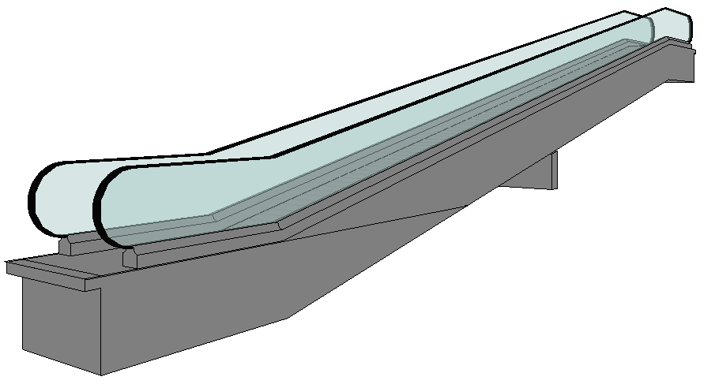
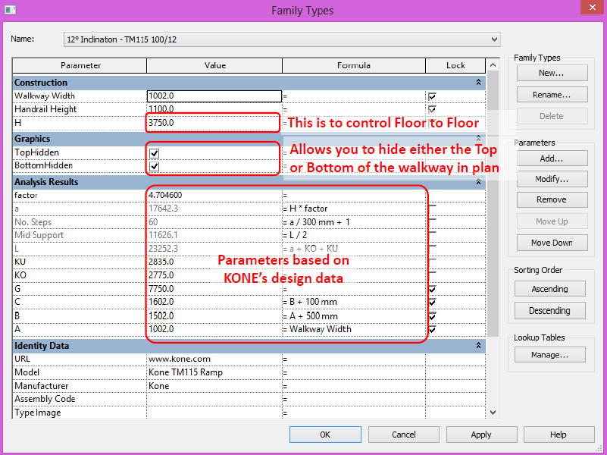
Business Impact
7 HOURS!
Notes:
For example, KONE Travellator, which took me around 7 hours back in 2009
In terms of the business impact, lost resources, time spent modelling manufacturers info.
How could we Reduce the impact? (Next Slide)

Slide 17
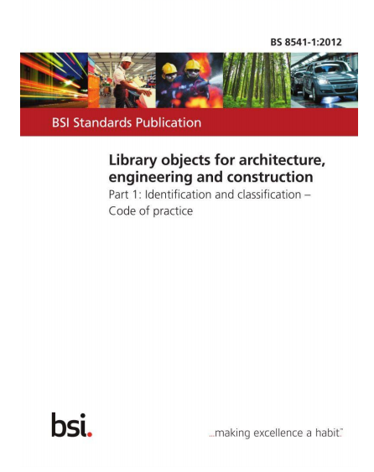
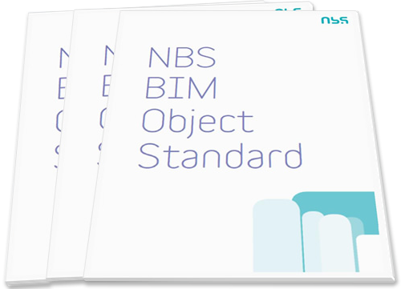
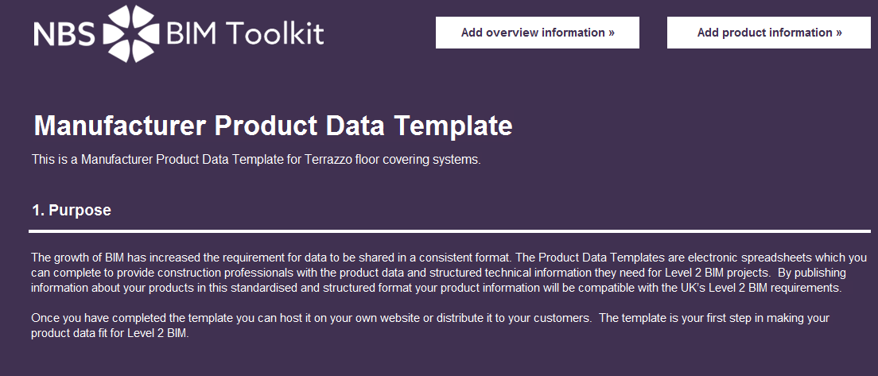
Business Impact
Object Modelling Standards
Product Data Templates (PDT’s)
Structured Data
Notes:
How could we Reduce the impact?
Modelling standards, LOD & LOI,
Standardising Data, enabling easier comparison's

Slide 18
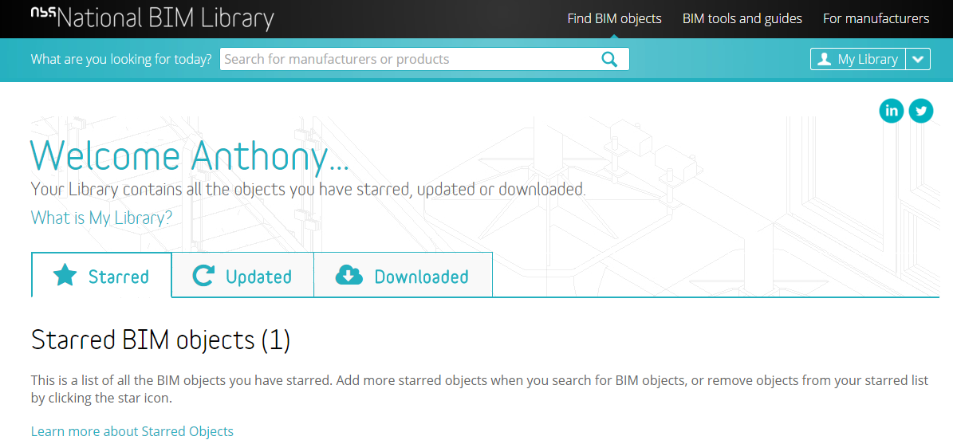
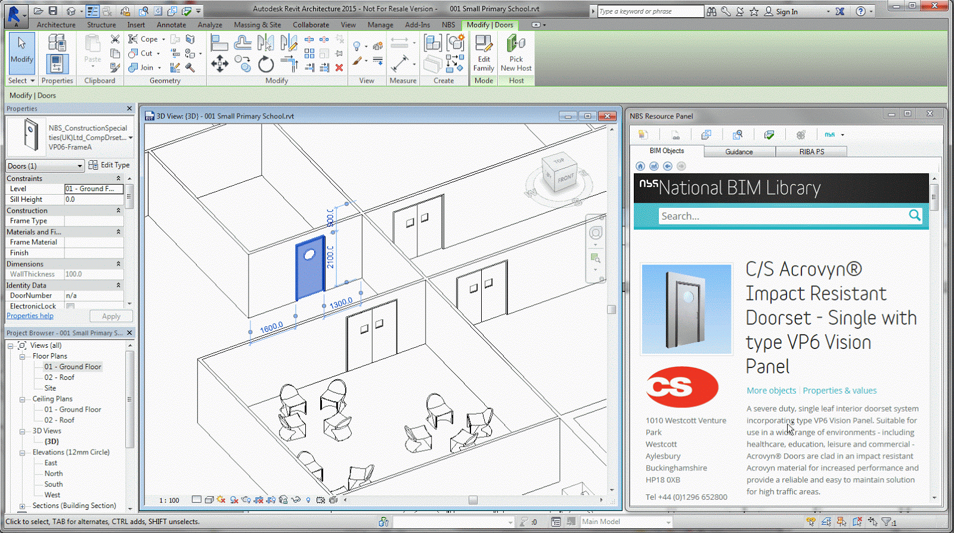
Notes:
Trusted downloadable content,
Designers can use an Add-in through their design software
Designers want to be working on projects – not creating manufacturers content – the manufacturers that provide are providing added value
it’s not just about coordinating the geometry – but also coordinating the information – the specification is an important part of the wider BIM ecosystem

Slide 19
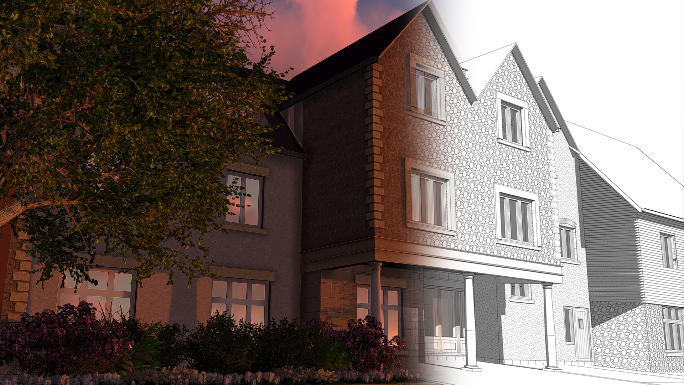
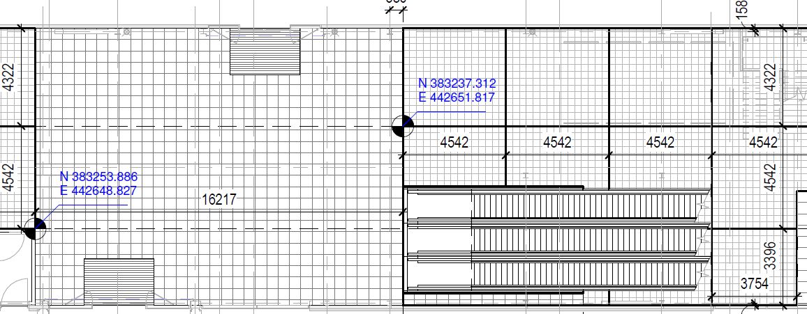
Business Impact
Costs to Create Specific Content
Absorbed by Business
Become knowledgeable in all aspects
Greater workload capacity
More Efficient, less resource
Notes:
Costs had to be absorbed
How to exchange files, Online Vault, IT equipment, software, licenses.
Noel Murphy, Site Manager - Drawing with the little Squares! Took Competition 2 weeks.

Slide 20
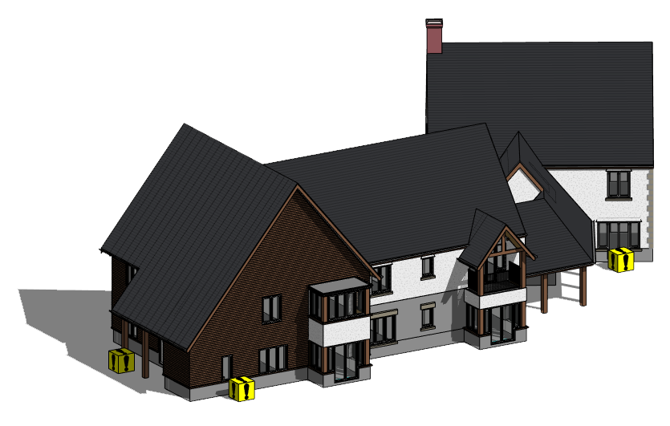
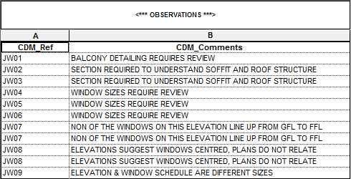
Incorporating Workflows
Health & Safety, Residual Risk Register
Rudimental Clash Identification
Quality Assurance & ISO9001
Filing System
Naming Conventions
Sketch & Feasibility Schemes
WebEx, Video Conference, On Site

Slide 21
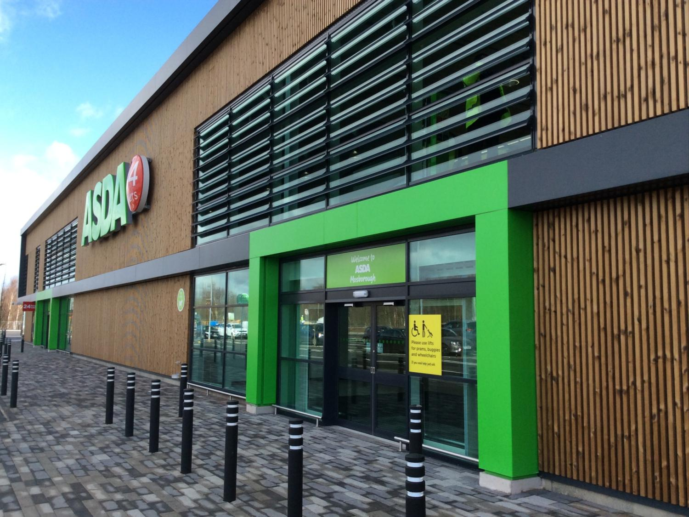
Incorporating Workflows
Notes:
Lets take a look on one of our recent schemes, Mosborough

Slide 22
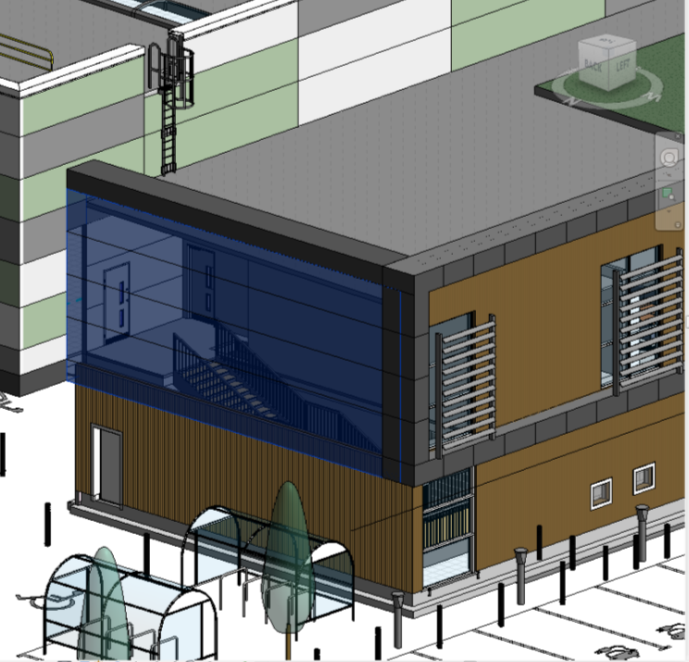
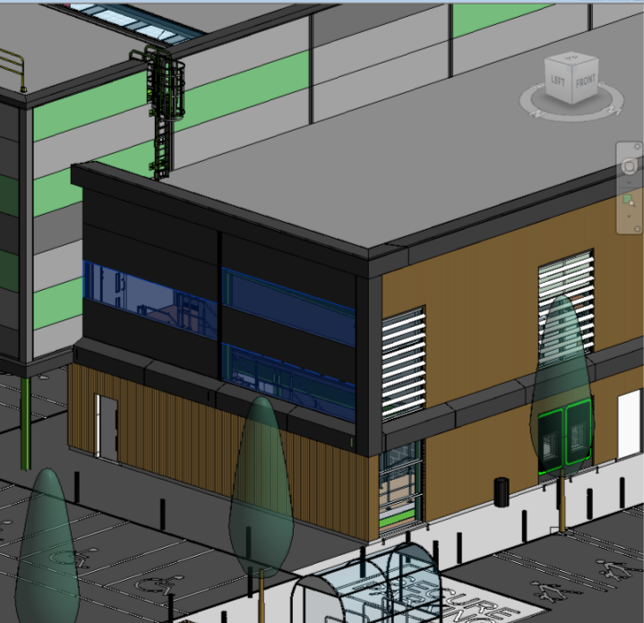
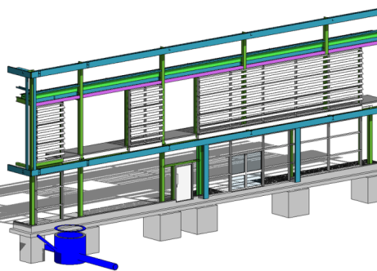
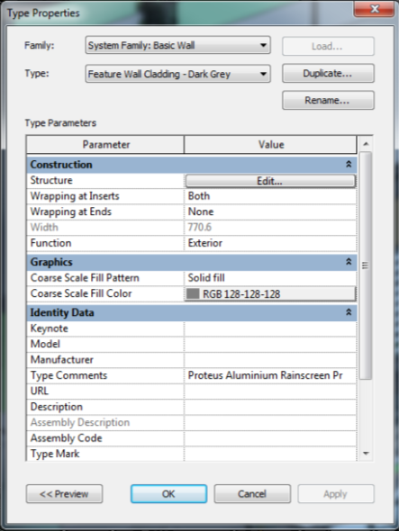
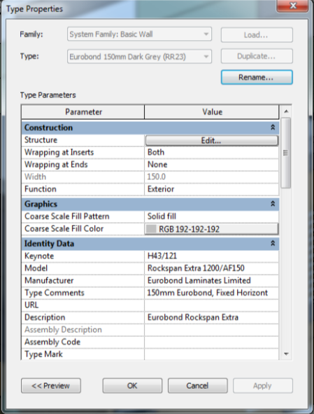
Generic Walls & Cladding
Greater LOD
(3D & Info)
Notes:
Employers Requirements Model – Speed & efficiencies
Construction Model – Refined & Defined Geometry & Data
Right Data, Right time

Slide 23
Future Opportunities
FUTURE
Moore’s Law is the observation that, computing hardware speeds double approximately every two years.
FUTURE TECH
Artificial Intelligence
2050
FUTURE TECH
“Predictive” Digital Decisions
2035
FUTURE TECH
Digital Decisions
Moore’s Law
2025
CURRENT TECH
Analogue Decisions
2016
NOW
Notes:
Great piece in the BIM2050 Working Group publication about the move to Digital Decisions, Predictive and ultimately AI.
But we can’t do this without meaningful, structured Data.

Slide 24
Future Opportunities
KIT OF PARTS
CREATE
BUILD
OPERATE
FEEDBACK
KIT OF PARTS
Standards
Bring together
Construct
Maintain
Update
FEEDBACK
CREATE
OPERATE
BUILD
Notes:
And ultimately through feedback, to make those digital decisions of the future we need to start harvesting the FM & Lifecycle data.

Slide 25
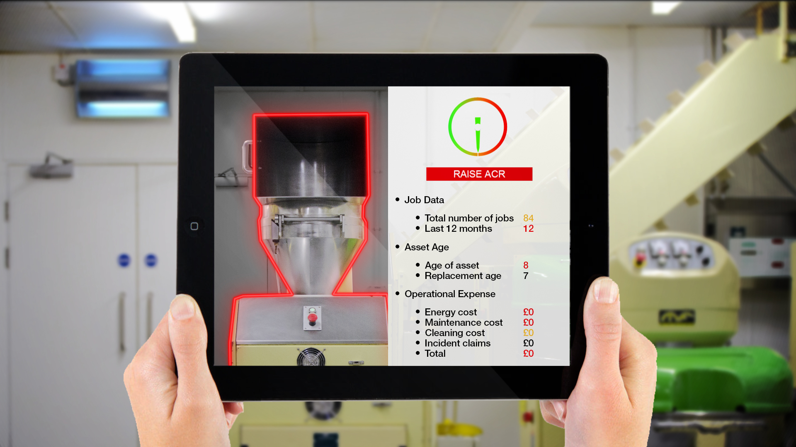
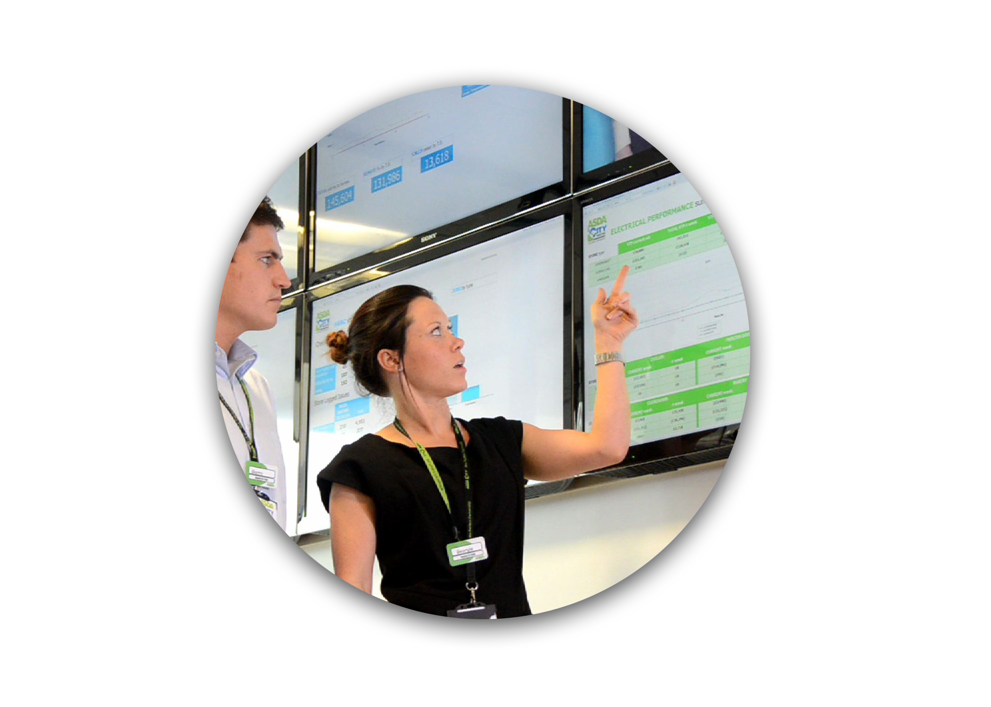
Feedback Change
Notes:
Large M&E Assets, but not at a Macro level just yet.
Imagine the possibilities if this was at a macro Level…

Slide 26
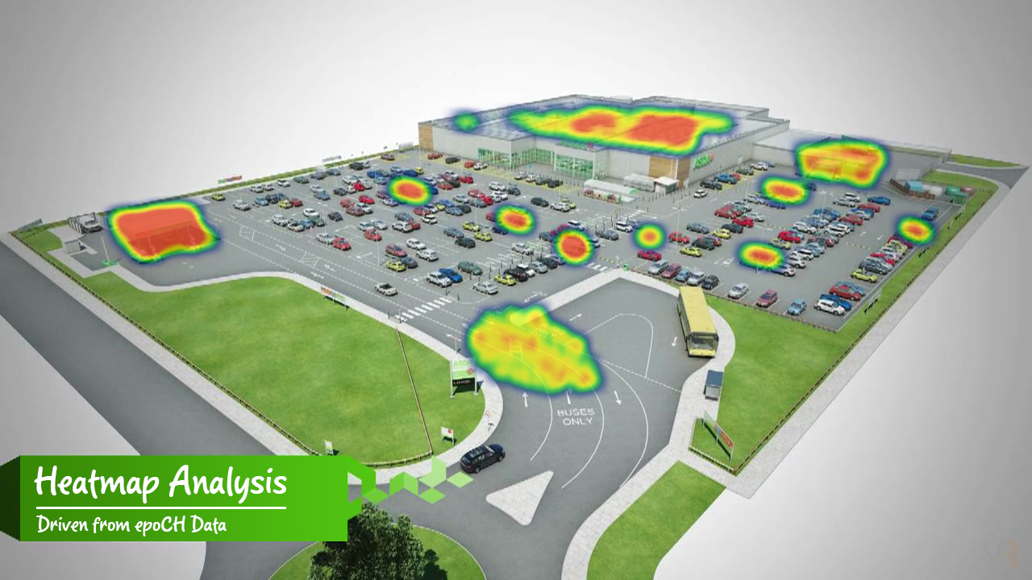
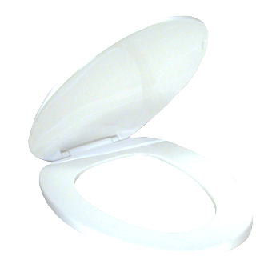
Future Opportunities
650 Stores
10 Per Store (Average)
6,500 Toilet Seats
£90 Seat, lasts 2 years
£8.7million over 30 years
£30 Seat, lasts 5 years
£1.1million over 30 years
£7.6m Saving
Notes:
Imagine a Virtual Live Heatmap, energy, maintenance, cleaning, incidents,
For example: Standard Asda Toilet Seat, 650 stores, 10 seats per store, 6,500 seats, lasted 2 years, replacement lasted 5.

Slide 27
2017.
Industry Shift
Warranty
Info
Specs
Trusted
Accurate
Evolve & Develop
Right Data
Geometry
& Specs
Notes:
So is Industry heading in 2017 and beyond,
A repository holding a library of component parts for re-use by consultants.
Trusted downloadable content, Designers can use an Add-in through their design software
Designers want to be working on projects – not creating manufacturers content – the manufacturers that provide are providing added value
it’s not just about coordinating the geometry – but also coordinating the information – the specification is an important part of the wider BIM ecosystem

Slide 28
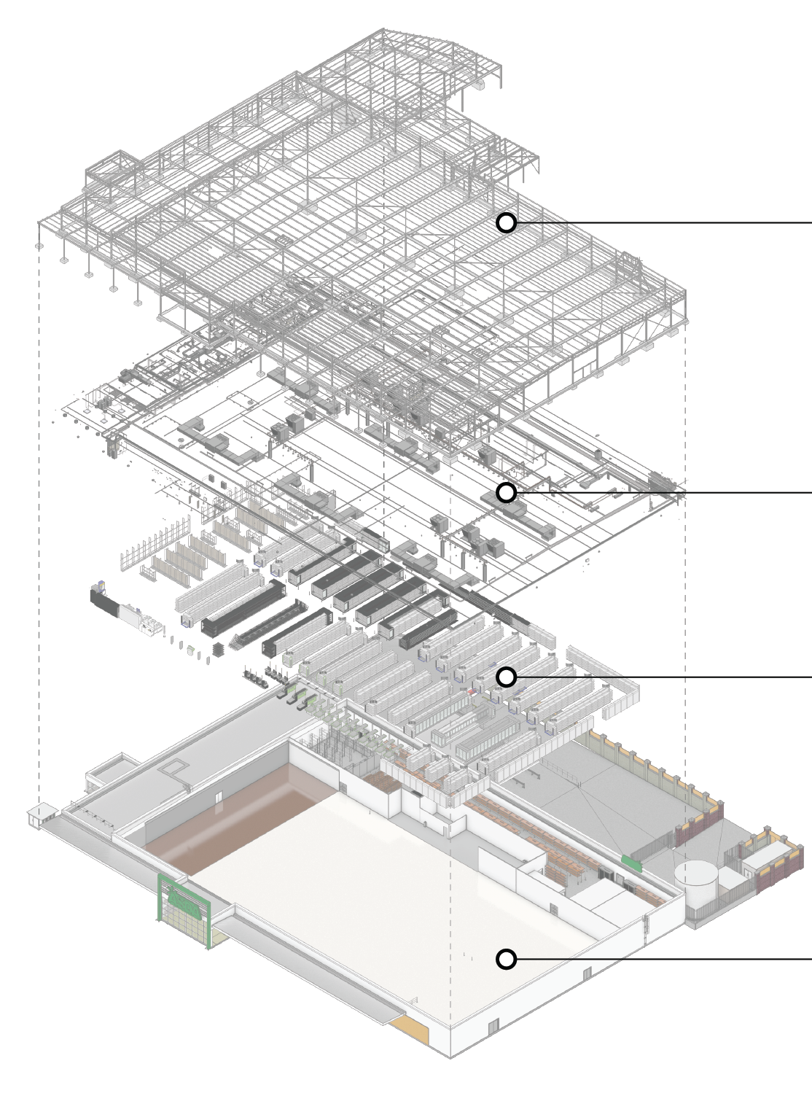
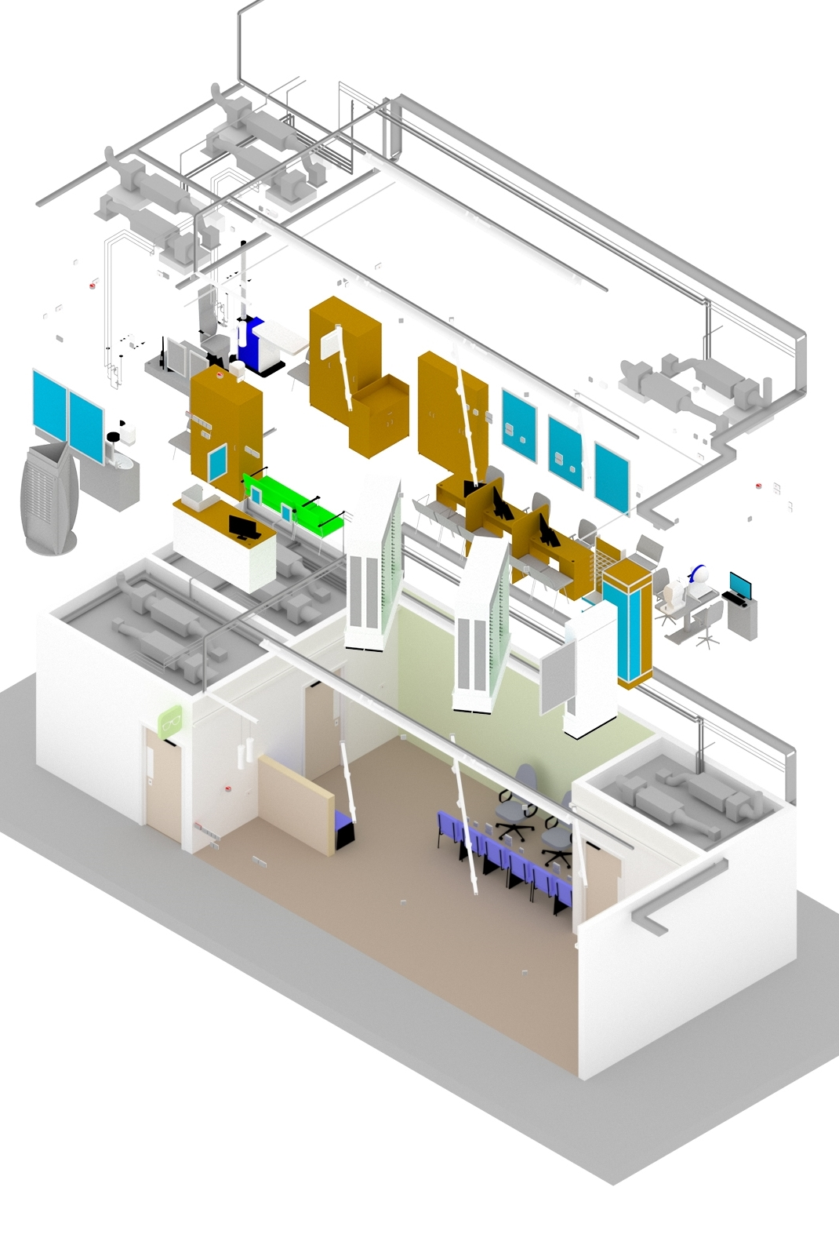
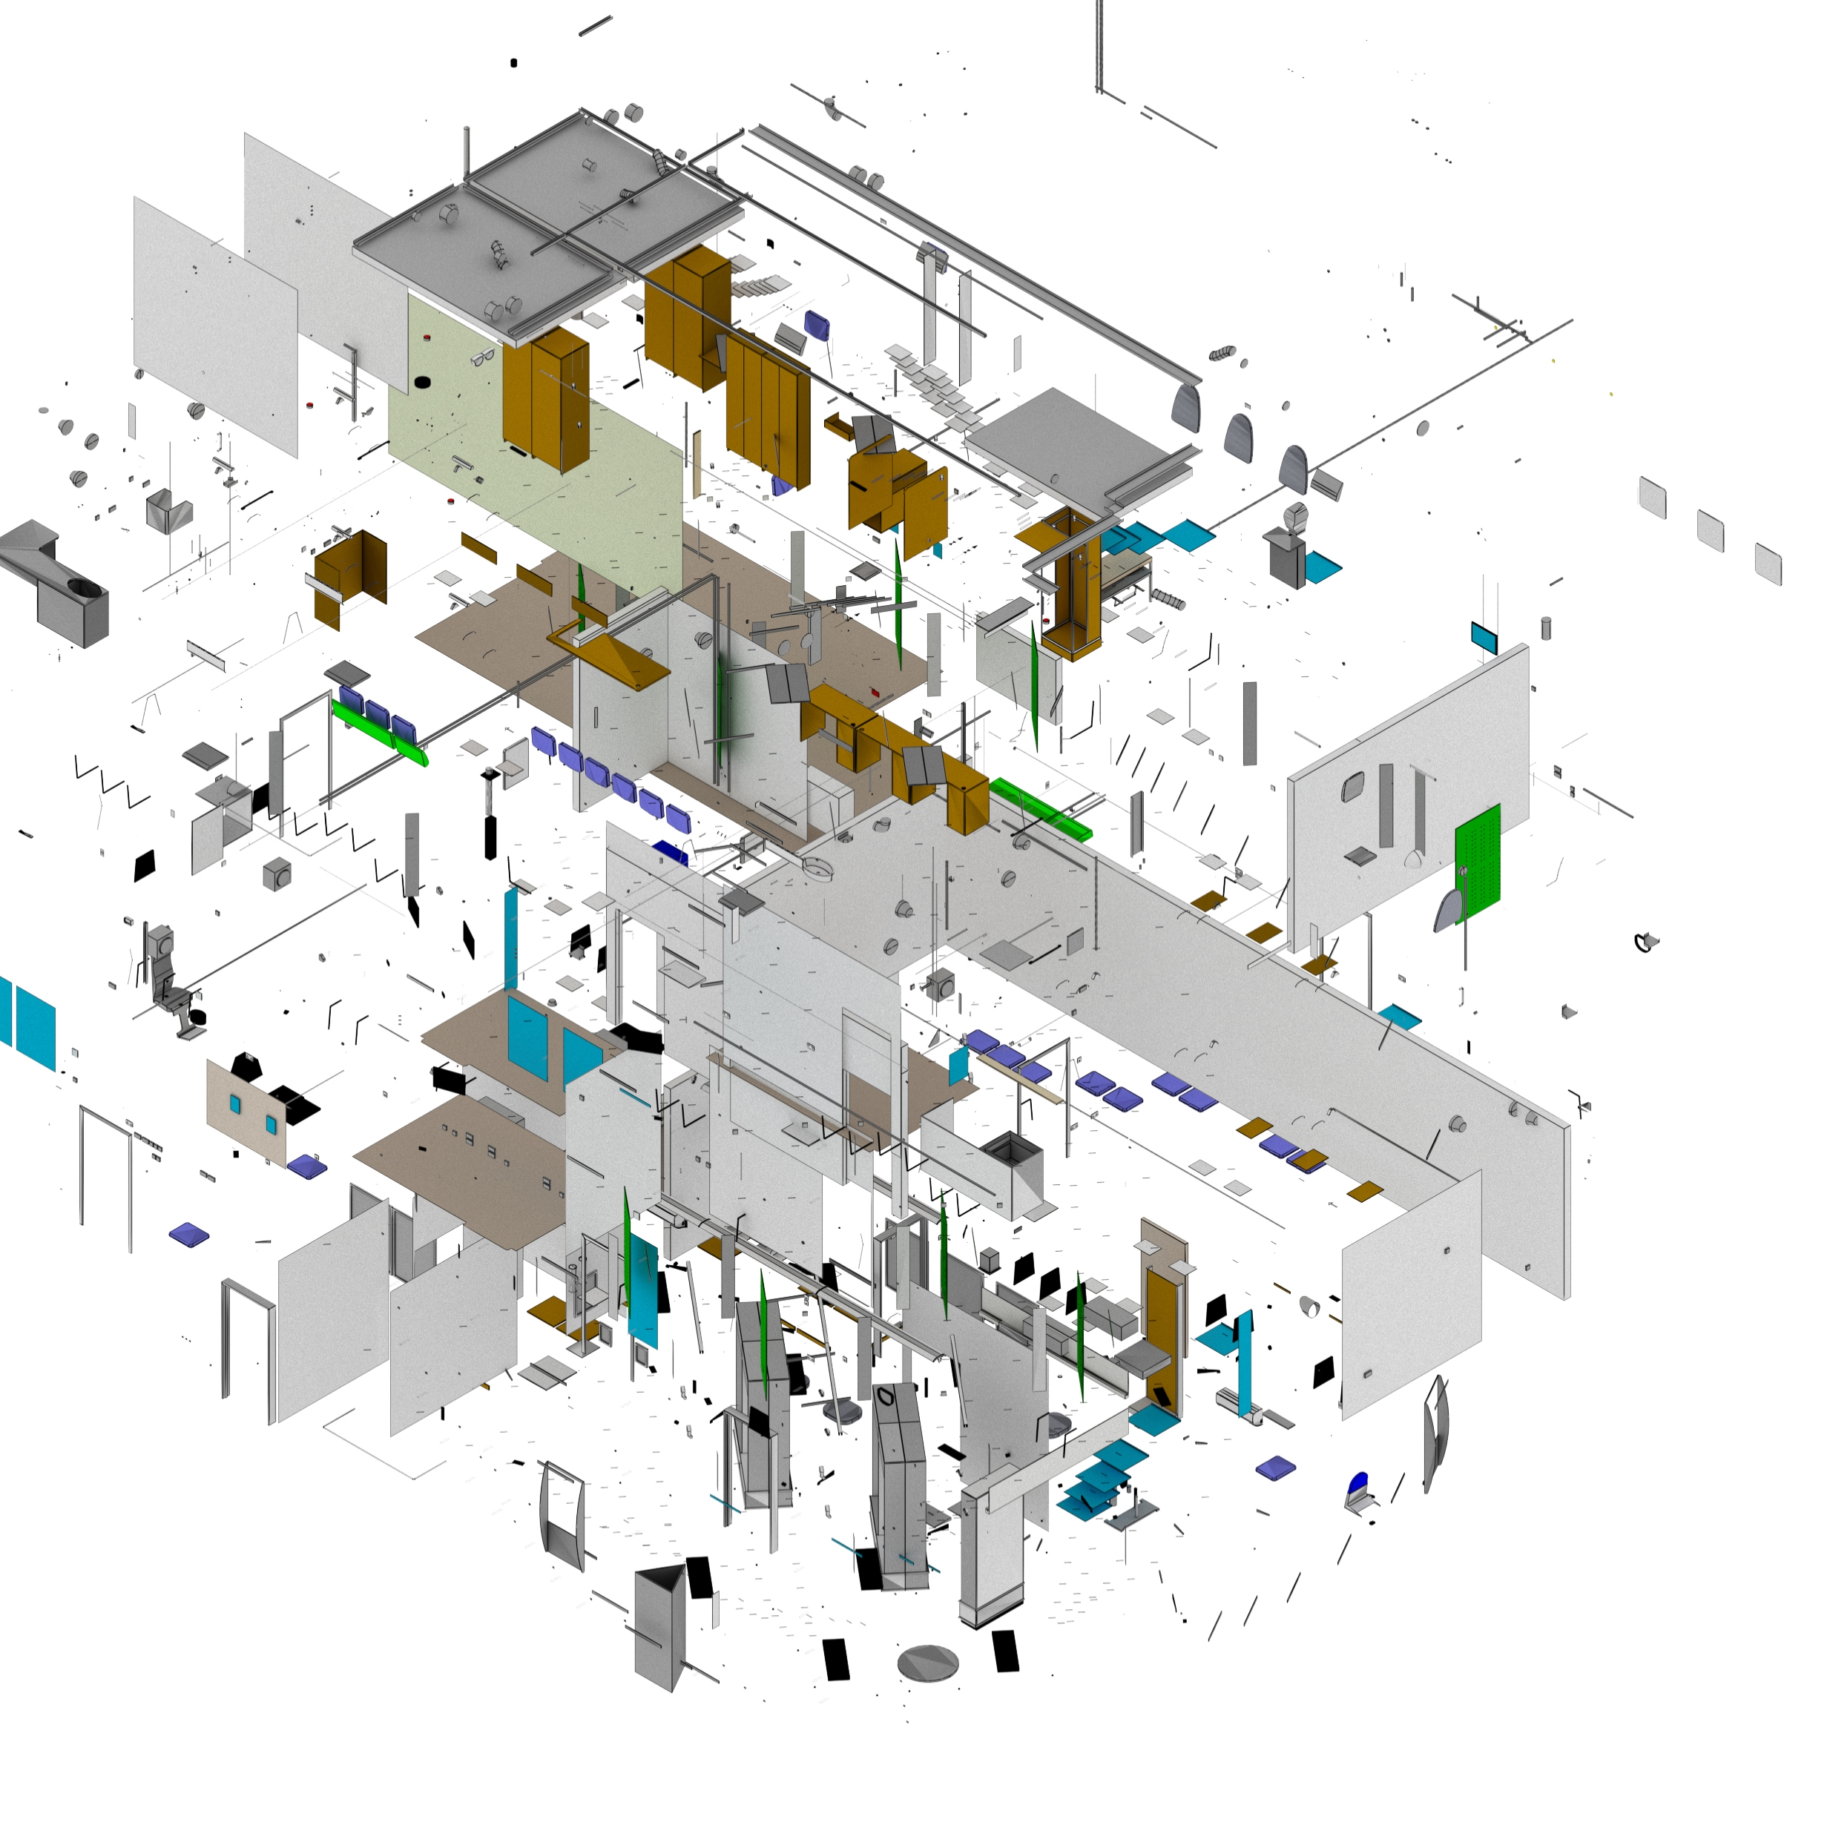
Store.
Dept.
Comp.
Notes:
Data at store level, department level and then component level.
Splitting down this standard kit of parts into it’s components, linking the data back to it’s original source.

Slide 29
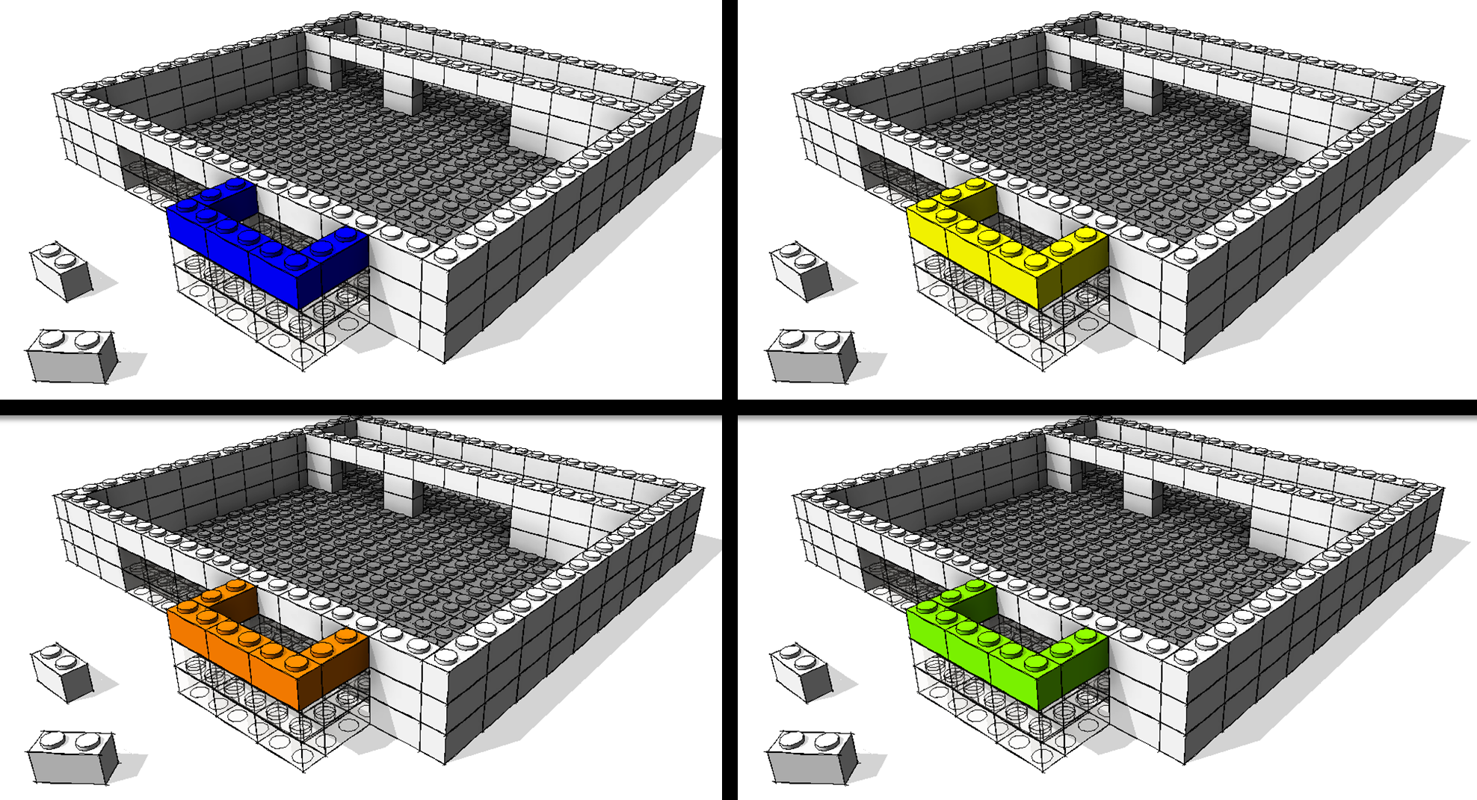
Notes:
Standard components, standard data…
All stores will use the same building materials, so we need to get to a position where the data and manufactures information becomes standardised throughout the industry.

Slide 30
To Recap
A Digital Future
My Analogy
What BIM is to me
Experiences in Adopting BIM
Why, When, How.
Impact on the Business
Time, Resources, Cost
How BIM is incorporated into workflows
ISO9001, Quality, Checking Procedure
Future Opportunities
Augmented Reality, Artificial Intelligence, Automated Decisions

Slide 31
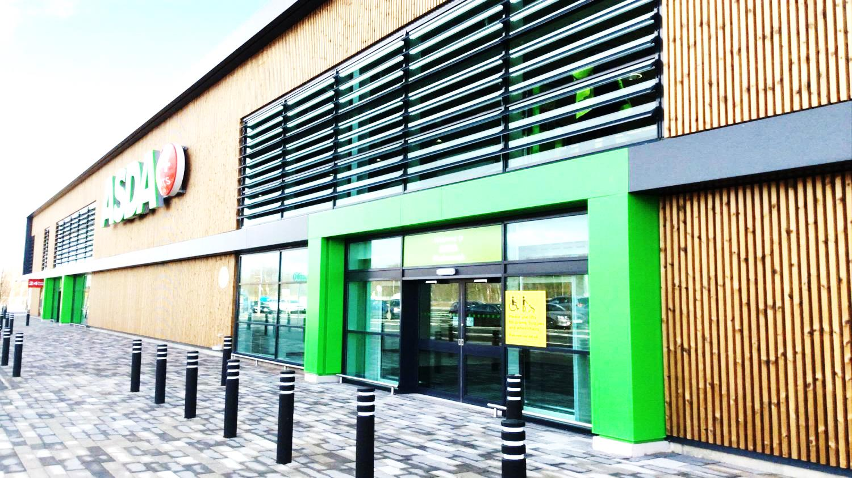
Thanks
@Anthony_Harte
@JamesWardLtd

